Slide 1
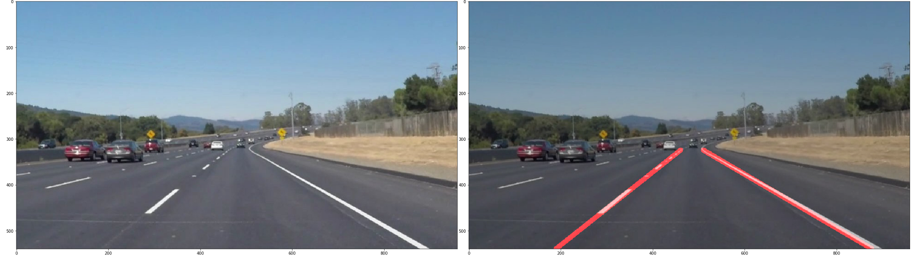
IMAGE PROCESSING ALGORITHMS FOR LANE DETECTION

Slide 2
FOLLOWINGS ARE CONCEPTS ANDTOOLS I USED IN LANEDETECTION:
1
Load and resize video source
2
converted to gray
3
Using histogram equalization function
4
5
mask image with declared parameters
HOUGH TRANSFORM

Slide 3
Converted to gray
To reduce the storage area of the image so
Reduce the processing time.

Slide 4
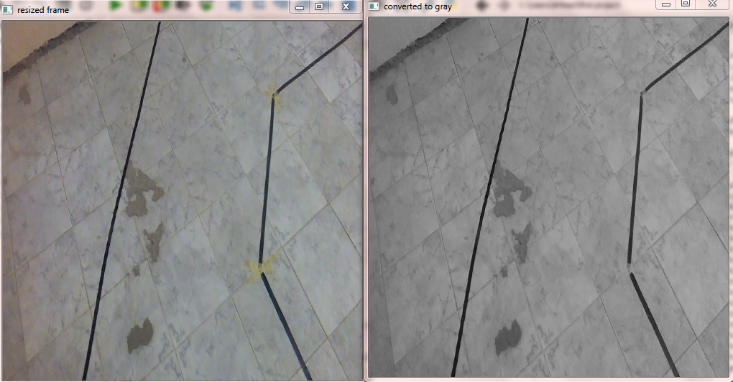
Converted to gray

Slide 5
Using histogram equalization function
Histogram equalization re-assigns the intensity values of pixels in the input image such that the output image contains a uniform distribution of intensities
equ = cv2.equalizeHist(gray)
video = cv2.cvtColor(equ,cv2.COLOR_GRAY2BGR)
hsv = cv2.cvtColor(video, cv2.COLOR_BGR2HSV)

Slide 6
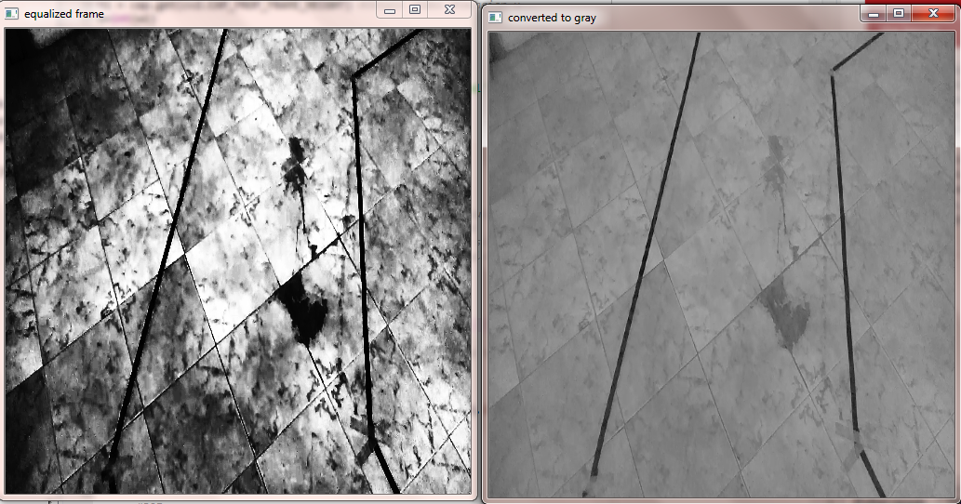
Using histogram equalization function

Slide 7
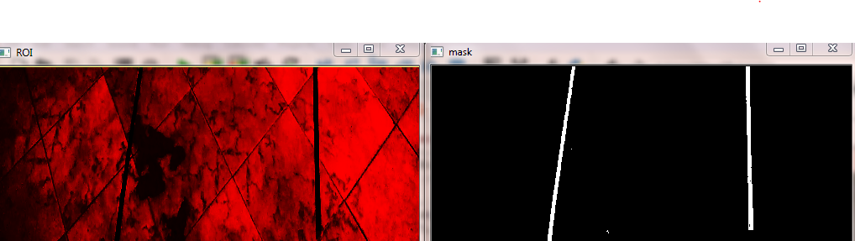
4. mask image with declared parameters
mask = cv2.inRange(grayROI,high_black,low_black)

Slide 8
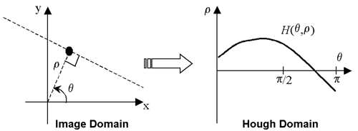
HOUGH TRANSFORM

Slide 9
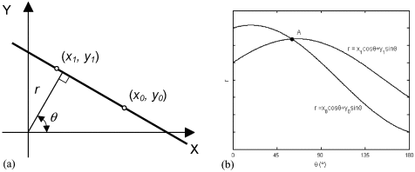
HOUGH TRANSFORM

Slide 10
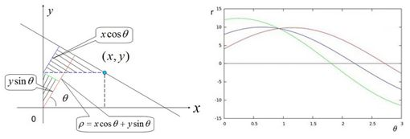
HOUGH TRANSFORM

Slide 11
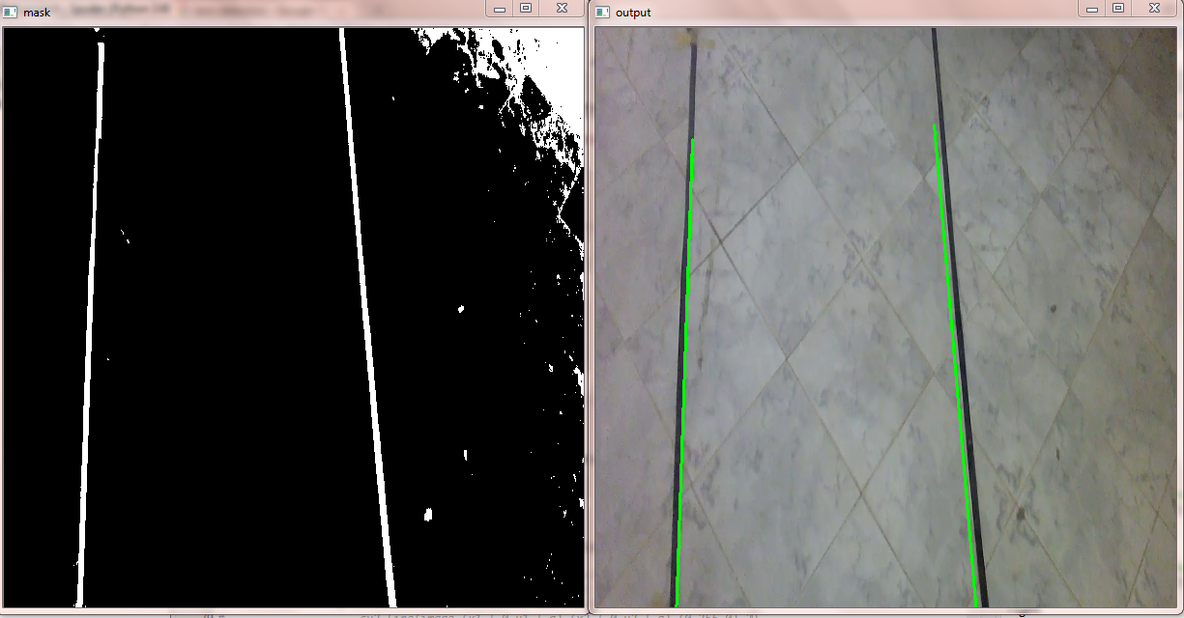
HOUGH TRANSFORM

